Slide 1


ROBOTICS
The Future of Automation
CSE Department Section: J Team: Pi-THOR IUBAT - International University of Business Agriculture and Technology

Slide 2
Team Pi-THOR
Name: Taj Nahar Ali Id: 26103168
Name: Nur e Jannat Id: 26103153
Name: Ratul Hassan Id: 26103152
Name: Md. Nafiz Uddin Id: 26103161
Name: Junaid Bhuiyan Id: 26103166
Name: Efazz Kadir Id: 26103175

Slide 3


Introduction to ROBO TECH VALLY
ESTABLISHED In
2019
A remarkable platform lighting the path for future innovators by transforming robotics education in Bangladesh
DHAKA, BANGLADESH
Road-4, RUPNAGAR,MIRPUR 2, DHAKA

Slide 4
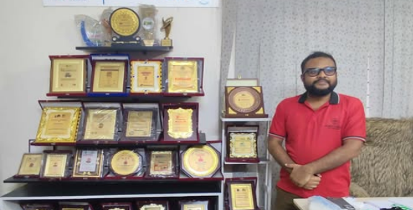
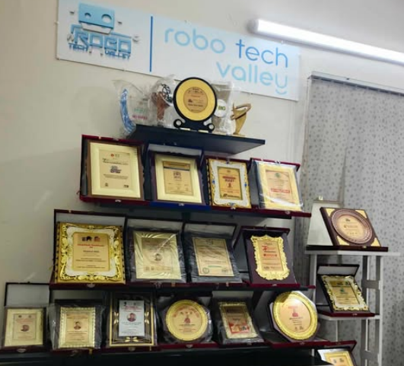
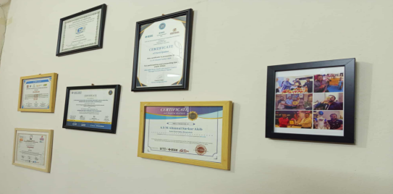
Robo Tech Valley

Slide 5




CORE INITIATIVES
Tech Labs
Robotics Kits
An innovation hub for mastering Android, Web, and Desktop application development through hands-on mentorship.
High-quality, DIY robotics components and kits designed to empower the next generation of engineers.
IoT Tools
Research
Smart sensors and connectivity modules for building advanced home automation and industrial IoT systems.
Driving technological breakthroughs in AI, Deep Learning, and Embedded Systems for a self-reliant Bangladesh.

Slide 6

METHODOLOGY
The goal was to explore how Robo Tech Valley promotes robotics education, innovation, and technical skills in Bangladesh and beyond.
Topic Selection:
Selected Robo Tech Valley as a case study to analyze its impact on the local robotics ecosystem and hands-on STEM education in Bangladesh.
Questionnaire Development:
Designed a structured survey for students and tech enthusiasts to measure the effectiveness of Robo Tech Valley’s training kits and workshops.

Slide 7
Industry Visit at Robo Tech Valley
We Reviewed the Following Questions:
System Architecture: What are the core hardware and software stacks used in your latest robotic units?
Navigation & Sensing: How does the robot handle real-time obstacle avoidance in dynamic human environments?
End-to-End Latency: What is the typical communication latency between the central controller and the actuators?
AI Integration: To what extent is Machine Learning used for computer vision versus hard-coded algorithmic logic?

Slide 8
We Reviewed the Following Questions
Safety Protocols: What fail-safe mechanisms are in place if a sensor or power system fails during operation?
Scalability: What are the biggest technical bottlenecks when moving from a prototype to mass production?
Power Efficiency: How do you optimize battery life for robots intended for 24/7 industrial use?
Maintenance: What is the MTBF (Mean Time Between Failures) for these systems under standard operating conditions?
Human-Robot Interaction (HRI): How is the UI/UX designed to allow non-technical staff to operate these robots?
Future Roadmap: How is the rise of Generative AI or 5G changing your approach to robotics development?

Slide 9
Key Findings & Strategic Insights
Field Analysis Summary:
Hands-On Pedagogy: Shift from theory to project-based, practical robotics training.
Universal Accessibility: Scalable curriculum designed for all age groups and skill levels.
Localized Innovation: Emphasis on in-house R&D and local hardware manufacturing.
National Alignment: Active contribution to STEM growth and national tech objectives.

Slide 10
Field Analysis Summary:
Global Competitiveness: Recognition and awards on the international robotics stage.
Workforce Readiness: Defined career pathways through specialized skill development.
Tech Convergence: Seamless integration of AI, IoT, and Industry 4.0 standards.
Ecosystem Building: Cultivating a strong, collaborative robotics community.
Academic Synergy: Strategic partnerships with schools and universities for talent pipelines.
Leadership Incubation: Structured mentorship to build the next generation of tech leaders.

Slide 11
RESEARCH & FIELD Objectives
Company Visit Analysis
Core Objective
Key Findings
Industry vs. Service Robotics
1. Operational Logic: How robots automate repetitive tasks. 2. Hardware Integration: Sensors and motor synchronization. 3. Future Scalability: Potential for Bangladesh's tech sector.
Identified the operational differences between heavy-duty industrial arms and assistive service robots.

Slide 12
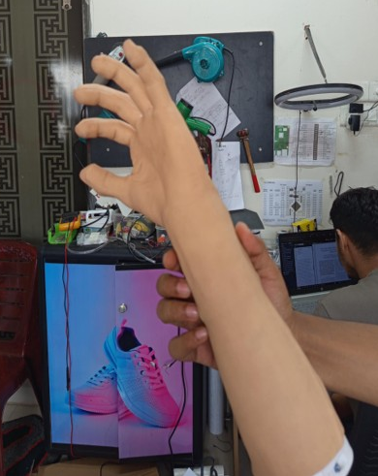
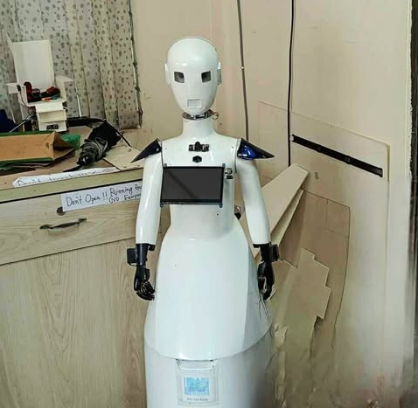
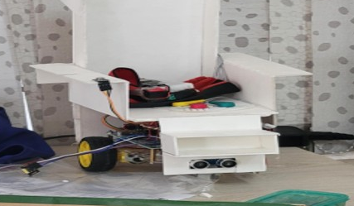
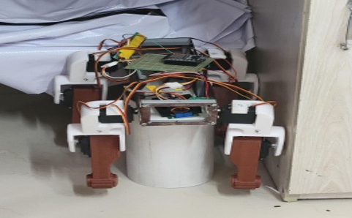
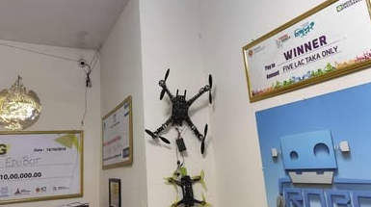
Technical Execution & Prototypes

Slide 13
Overall Impact
"This experience was not just academic - it was transformational."
It gave us deeper motivation and clearer direction for our future.
Vision
"Connecting technology with education on the global map."

Slide 14

THANK YOU
We welcome your Questions. Feel free to ask.
Slides by Md. Nafiz Email: md.nafiz2023@gmail.com Facebook: Muhammad Nafiz

